Slide 1


Slide 2

About us:
Team members:
Lakshmi Tulasi
Jyothi
Sushma

Slide 3
Problem Statement:
Heart disease is one of the leading causes of death worldwide. Early detection and risk assessment are crucial to prevent severe health complications. However, traditional diagnosis methods can be time-consuming and dependent on expert interpretation.
Objective:
The objective of this project is to develop a machine learning-based system that predicts the risk stage of heart disease using patient clinical and medical attributes. The system aims to compare multiple algorithms and select the most accurate model for reliable prediction and early decision support.

Slide 4
Simple EDA :
Analyzed target variable (StagesOfHDrisk) to check class distribution and imbalance.
Used count plots and boxplots to study relationship between age, cholesterol, and heart disease risk.
Created correlation heatmap to identify important features affecting heart disease.
Detected outliers and data patterns before model training.
EDA helped in better feature selection and improved model performance.

Slide 5
Data Cleaning:
Used KNN Imputer to fill missing numerical values based on similar patients.
Used Random Forest model to predict missing categorical features like chest pain and Thal.
Handled Boolean features (fasting sugar, exercise angina) using ML-based prediction instead of simple mode filling.
Detected and treated outliers using the IQR method to reduce extreme value impact.
Applied preprocessing (Scaling, One-Hot Encoding, SMOTE) to make the dataset clean, balanced, and model-ready.

Slide 6
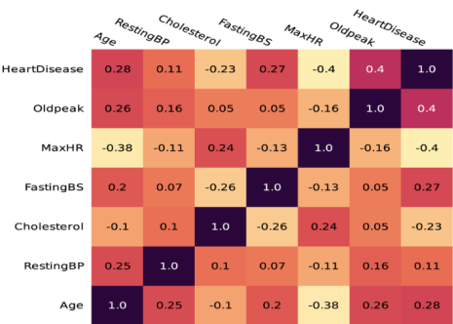
Correlation Matrix:
Oldpeak (0.40) - Higher Oldpeak → Higher chance of heart disease
Important feature
MaxHR (-0.40) - Higher MaxHR → Lower chance of heart disease
Very important feature
Age (0.28) - Older age → Slightly higher risk
FastingBS (0.27) - High fasting blood sugar → Higher risk
Cholesterol (-0.23) - Surprisingly weak negative relation in this dataset
RestingBP (0.11) - Almost no strong effect
Strong Relationships Between Features
Age & MaxHR = -0.38
→ Older people tend to have lower MaxHR.
Cholesterol & FastingBS = -0.26
→ Mild negative relation.
Most useful features for predicting HeartDisease:
Oldpeak, MaxHR, Age, FastingBS

Slide 7
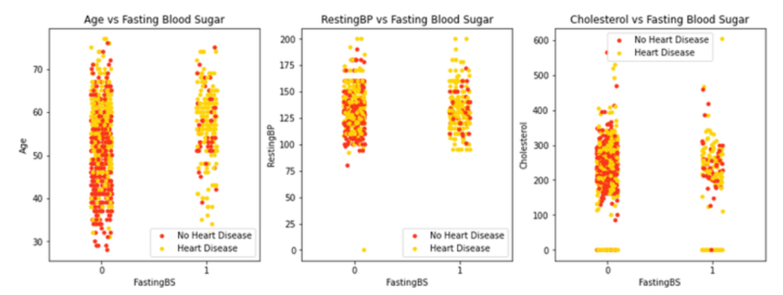

Slide 8
Preprocessing
The dataset contained numerical and categorical features that required transformation before training.
Numerical features were standardized using Standard Scaler.
Categorical features were converted using One-Hot Encoding.
A Column Transformer Pipeline was used to apply all transformations efficiently.
This ensured clean, structured, and model-ready data for accurate prediction.

Slide 9
Preprocessing Techniques used:
Missing Value Imputation
  KNN Imputer / Median / Mode filling
Feature Scaling
  Standard Scaler (Normalization of numerical features)
Categorical Encoding
  One Hot Encoding
Column Transformation
  Column Transformer (Apply different transformations to different columns)
Pipeline Implementation
  Scikit-learn Pipeline (Combine preprocessing + model training)

Slide 10
Model Building:
After preprocessing, the dataset was split into training and testing sets.
Three machine learning algorithms were implemented:
Support Vector Machine (SVM)
Random Forest
XG Boost
Each model was trained and evaluated using performance metrics such as Accuracy and F1-Score.
After comparison, SVM achieved the best performance among the three models.
Therefore, SVM was selected as the final model for heart disease risk prediction.

Slide 11
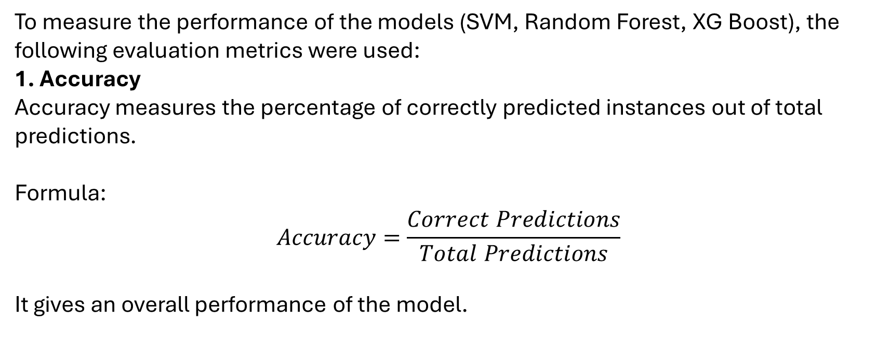
Evaluation Metric:
To measure the performance of the models (SVM, Random Forest, XG Boost), the following evaluation metrics were used:
1. Accuracy
Accuracy measures the percentage of correctly predicted instances out of total predictions.
Formula:
$$Accuracy=\frac{Correct Predictions}{Total Predictions}$$
It gives an overall performance of the model.

Slide 12
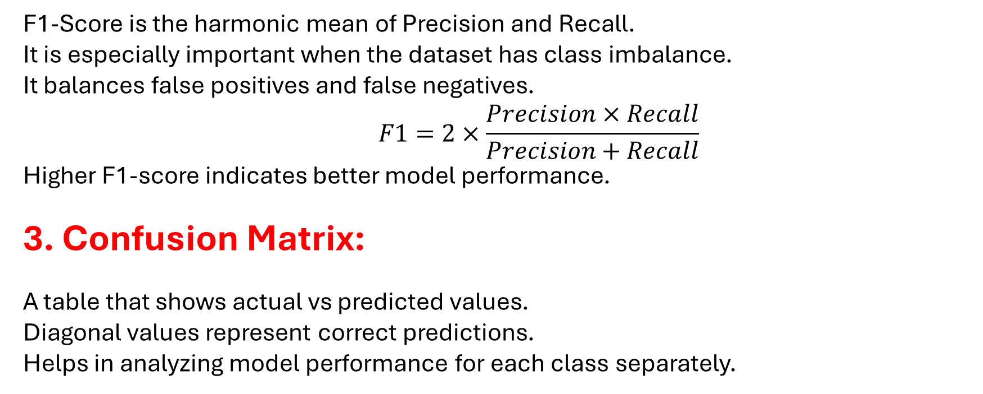
2. F1- Score:
F1-Score is the harmonic mean of Precision and Recall.
It is especially important when the dataset has class imbalance.
It balances false positives and false negatives.
$$F1=2×\frac{Precision×Recall}{Precision+Recall}$$
Higher F1-score indicates better model performance.
3. Confusion Matrix:
A table that shows actual vs predicted values.
Diagonal values represent correct predictions.
Helps in analyzing model performance for each class separately.

Slide 13
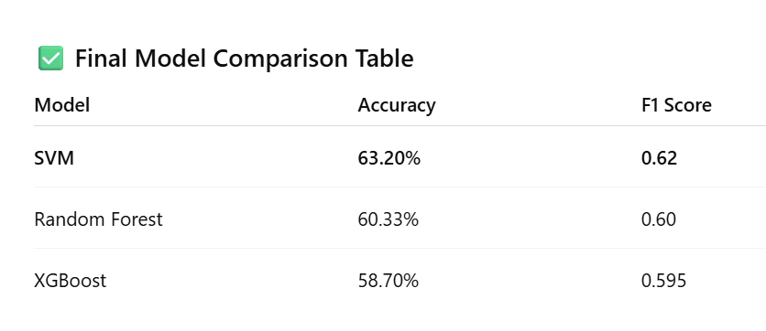

Slide 14
Hyperparameter Tuning:
Hyperparameter tuning was performed using Optuna to improve model performance.
For SVM, parameters such as C (regularization) and Gamma were optimized.
For XG Boost, parameters like learning rate, max_depth, and n_estimators were tuned.
The best parameter combination was selected based on F1-score, resulting in improved accuracy and better generalization.
After tuning, the best parameter combination was selected and used to train the final model.

Slide 15
Shap Analysis:
SHAP was used to interpret the XG Boost model predictions.
It helps in understanding how each feature contributes to the final prediction.
SHAP values show the impact (positive or negative) of each feature on heart disease risk.
Global feature importance was calculated by taking the mean absolute SHAP values.
This improves transparency and makes the model more explainable.

Slide 16
Prediction using XIA(SHAP):
Explainable AI (XAI) was used to interpret model predictions.
SHAP explains how each feature contributes to increasing or decreasing heart disease risk.
It provides transparency by showing why a particular prediction was made.
This improves trust and reliability of the model in medical applications.

Slide 17
Conclusion:
This project, we predicted heart disease risk using Machine Learning.
We cleaned the dataset and handled missing values properly.
We analyzed important features using EDA and correlation matrix.
Models like XG Boost, SVM, and Random Forest gave good accuracy.
This system can help in early detection of heart disease.

Slide 18

16

